Slide 1
Are Employee-Owned Firms Luddites? Effects of Ownership on Adoption of Robots and Employment after Adoption
Adrianto¹, Avner Ben-Ner¹, and Ainhoa Urtasun²
¹University of Minnesota and ²Public University of Navarre
Kelso Workshop
January 12-14, 2024

Slide 2
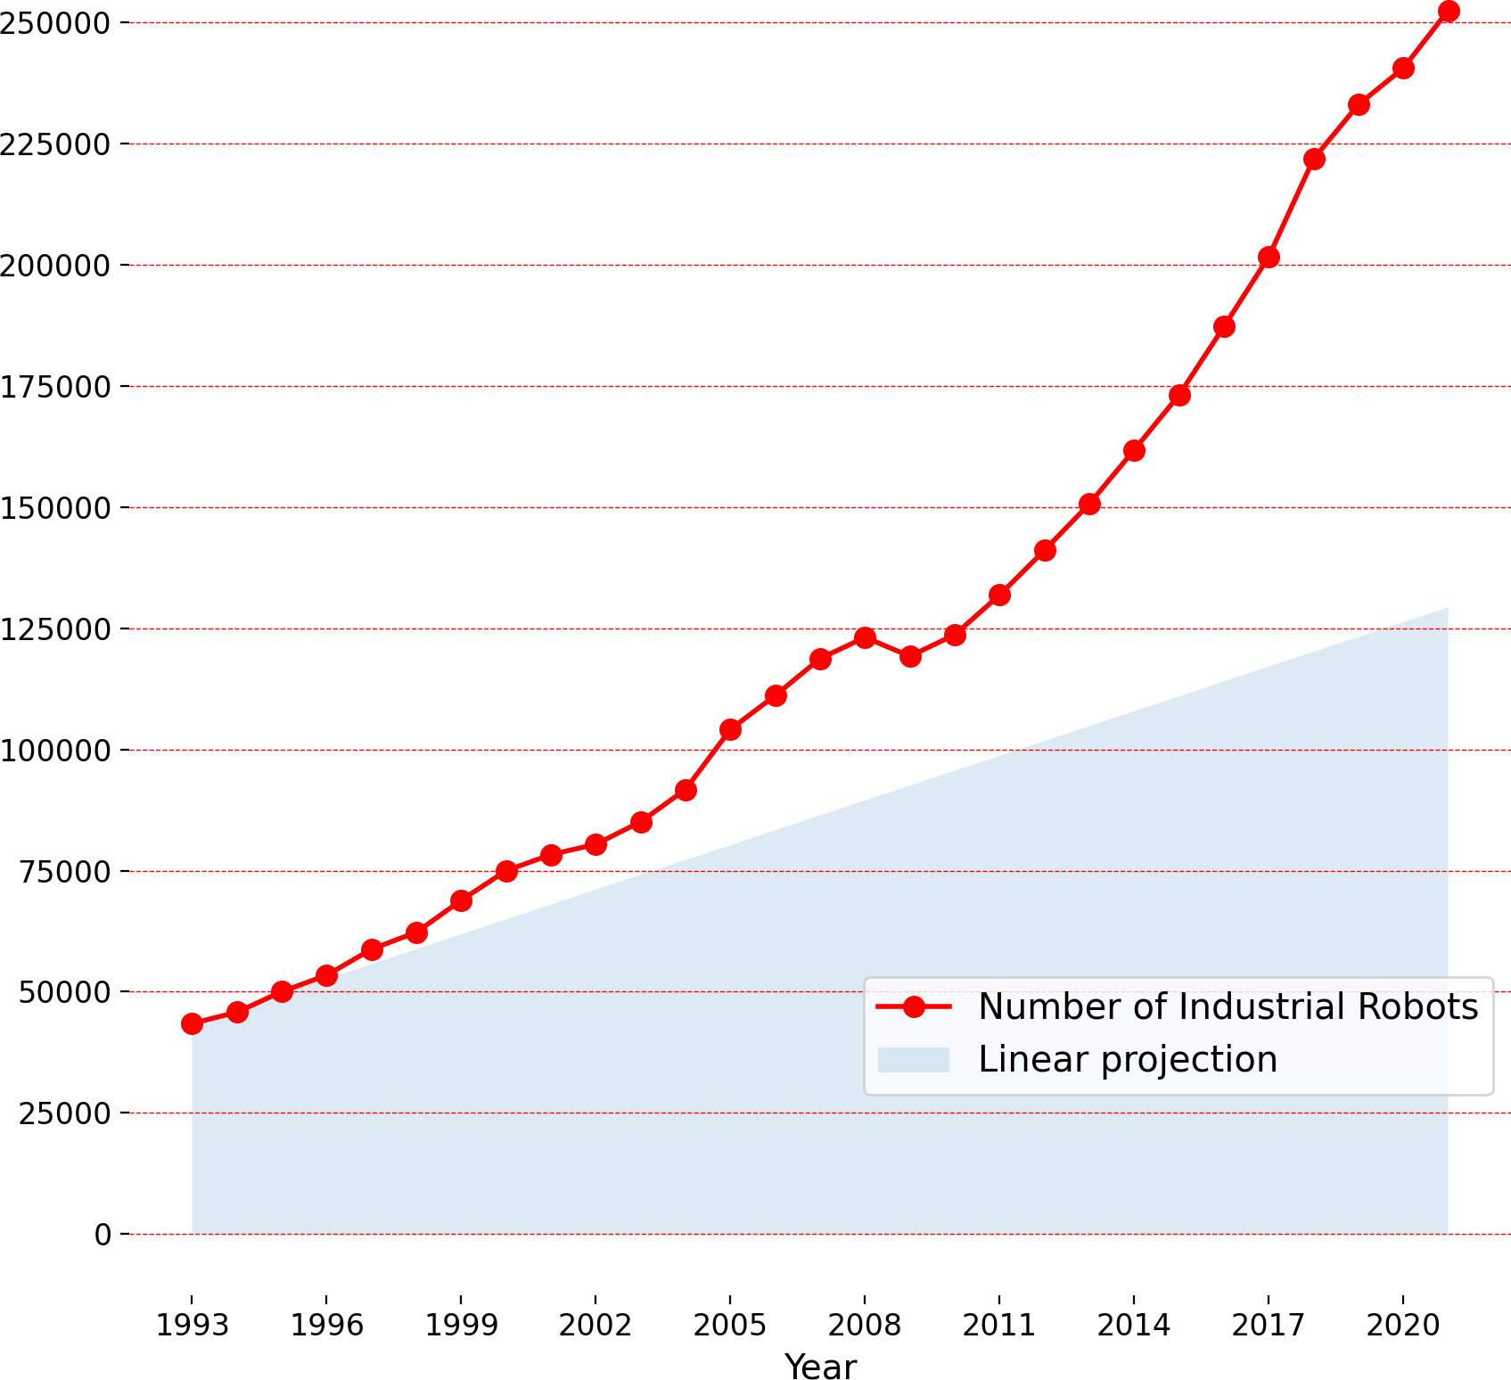
Stock of Industrial Robots in the US (1993-2021)

Slide 3
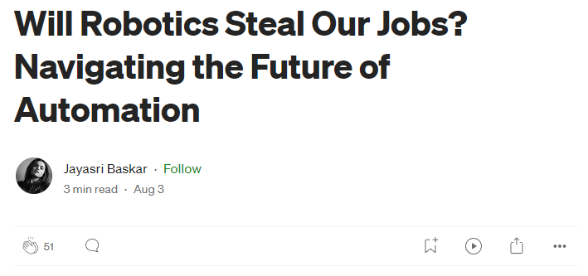
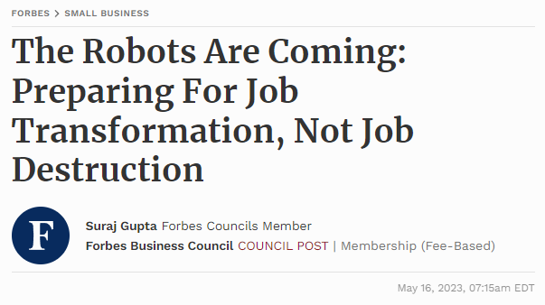
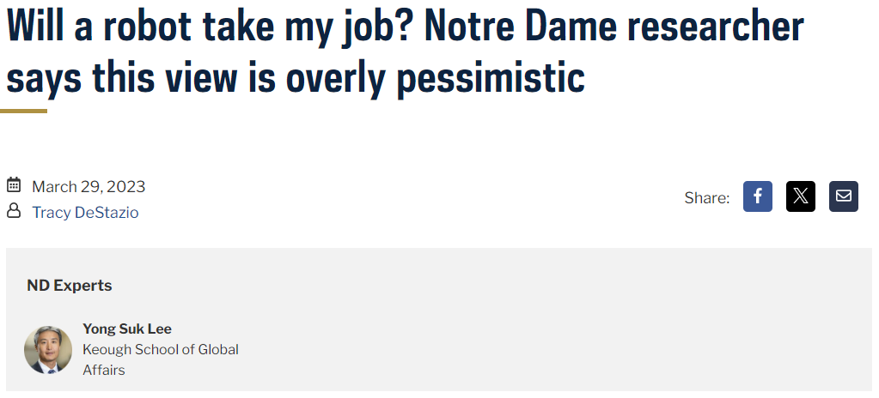
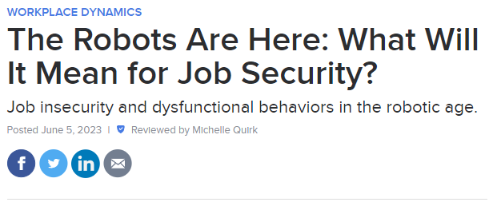

Slide 4
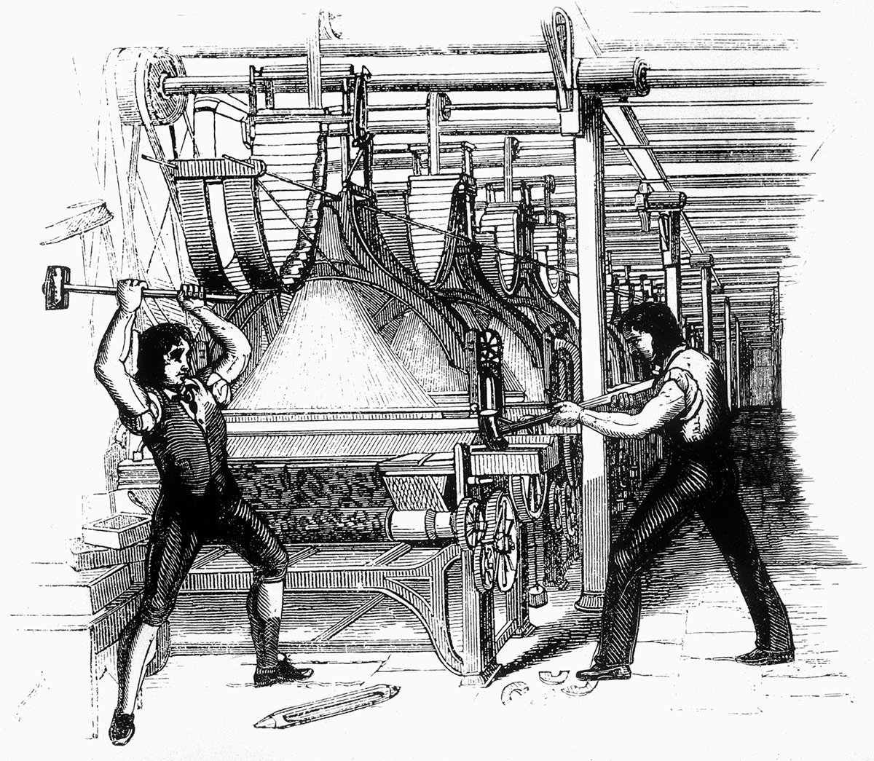
Luddite Riots
Occurred in 19th century England, marked by significant industrialization in the textile industry
Opposed the introduction of new machinery (automated looms, knitting frames) fearing they would replace traditional craft skills and lead to unemployment
Contributed to the broader labor movement, fostering discussions on workers' rights and the need for collective bargaining

Slide 5
Labor and automation
Historically, unions opposed manufacturing automation such as mechanization and early numerical control/CNC machines that threatened skilled jobs (Noble*)
There is very limited research on the effect of unions on adoption of automation
It appears that in countries with work councils, unions collaborate in the introduction of automation technologies**
There is no research evidence about the introduction of automation in firms with employee-owned firms (EOFs)***
*Noble, D.F., 1986. Forces of production: A social history of industrial automation
**Haipeter, Thomas. "Digitalisation, unions and participation: the German case of ‘industry 4.0’." Industrial Relations Journal 51.3 (2020): 242-260.
***During a recent visit to two Mondragon coops the CEOs argued that there is no opposition to autpmation because nobody would lose their job but will enjoy the benefits of greater productivity.

Slide 6
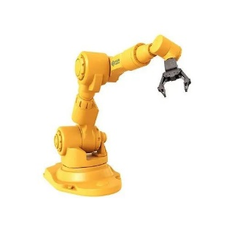
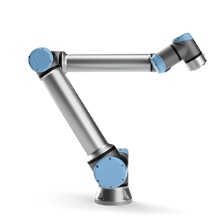
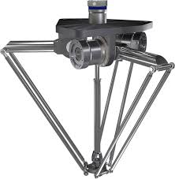
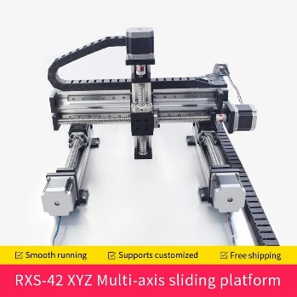
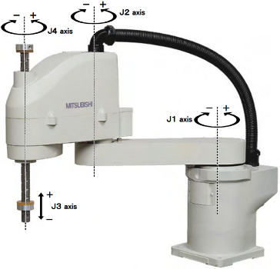
Industrial Robots
Articulated Robot Arms. These are the most comon. They have articulated arms with multiple joints: welding, assembly, material handling.
Collaborative Robots (Cobots). Designed to work alongside humans in a collaborative manner. Equipped with sensors and safety features.
Delta Robots. Used in high-speed assembly and packaging. Three arms connected to a central joint to move quickly and precisely.
SCARA Robots. Selective Compliance Assembly Robot Arm. High speed accurate assembly tasks (screwdriving, pick-and-place)
Cartesian (Gantry) Robots. Three linear axes (X, Y, Z) can move independently in a rectangular coordinate system. Used for precise repetitive movements (CNC machining and 3D printing).
Delta robots in action video

Slide 7
Research questions
Do firms with employee ownership (EOFs) and conventional firms (CFs) differ in their propensity to adopt robots?
Do unions affect the difference, if any?
Do EOFs and CFc that adopt robots change their employment levels differently after they adopt robots?
Context:
US manufacturing
EOFs are firms with ESOPs
CFs are conventional firms

Slide 8
Theoretical considerations 1
EOFs advance worker well-being more than CFs
Both production workers and managers enjoy greater well-being (Adrianto, Ben-Ner, Sockin and Urtasun 2024)
EOFs value employment stability (Kurtulus and Kruse, 2018)
EOFs provide greater workplace safety for production workers (Adrianto et al. 2024)
Therefore, if robots improve workers’ well-being, particularly employment and safety, they are more likely to adopt them than peer CFs

Slide 9
Theoretical considerations 2
Empirical findings at the firm and plant level suggest that adoption of robots is associated with an increase in employment of both high skill and low skill workers and raise productivity (Koch et al. 2021, Dixon et al. 2021, Acemoglu et al., 2023; Humlum, 2022, Adrianto, Ben-Ner & Urtasun 2024) and increase workplace safety (ABU in progress)
Therefore:
Hypothesis 1. EOFs are more likely to adopt robots than CFs facing similar circumstances (industry, size)
Hypothesis 2. Following robot adoption, EOFs will decrease less/increase more employment than peer CFs

Slide 10
Our study
We study the adoption of robots in US manufacturing plants 2010-2022
We assess the change in hiring before/after adoption compared to similar non-adopters
Data: job postings (BGT), ESOPs (F5500), unions (NLRB)
Robot adoption = the first year a plant posts at least x technical workers jobs that require robots-related skills

Slide 11
Data and Sample
Original dataset: 19,390,101 US manufacturing online job postings from 1.3 million establishments during 2010-2022
We perform geolocation and firm name clean-ups
How we identify manufacturing plants:
Job postings are grouped into occupations: high-technical, medium-technical, low-technical (including direct occupations), and others.
Direct occupations: assemblers, welders, painters, packagers, handlers
Recruiters and sparse plants (with three or more years of zero posting) are removed.
Variables:
Size proxy: Total number of job postings
1(Union): 1 = Unionized (combining NLRB and LM10)
1(Collective bargaining): 1 = Collectively-bargained EOF (NCEO)
Threshold:
Criterion | Threshold
% sales job postings | < 10%
% technical high-skill job postings | >= 2 postings
% technical low-skill job postings | >= 2 postings
Average annual number of postings | >= 7 postings

Slide 12
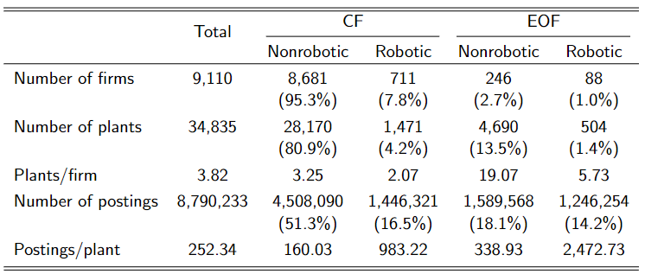
Descriptive statistics

Slide 13
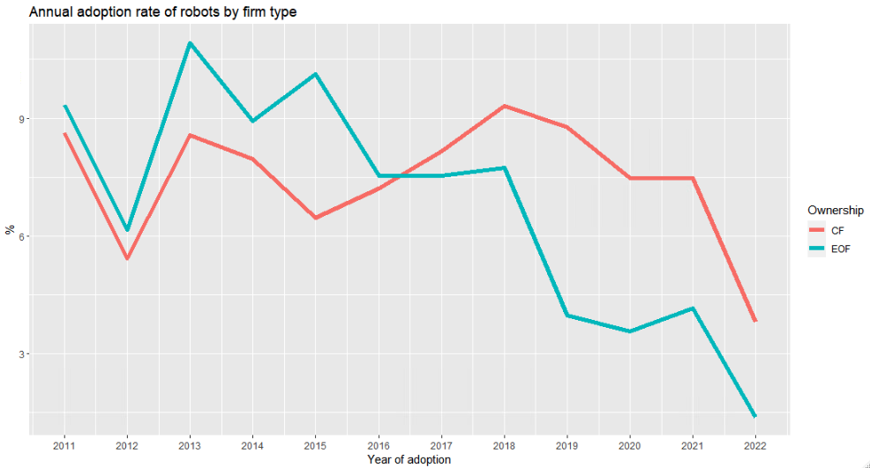
Adoption rates by ownership type

Slide 14
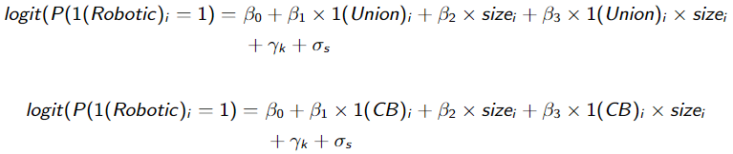

Empirical strategy
Logistic regression
Are EOF more/less likely to adopt robots?
Do unions affect this relationship? Does a CB EOF matter?
Difference-in-difference (Callaway and Sant’Anna, 2021)
Conditional on adopting robots, do EOF/CF change their hiring intensities?

Slide 15
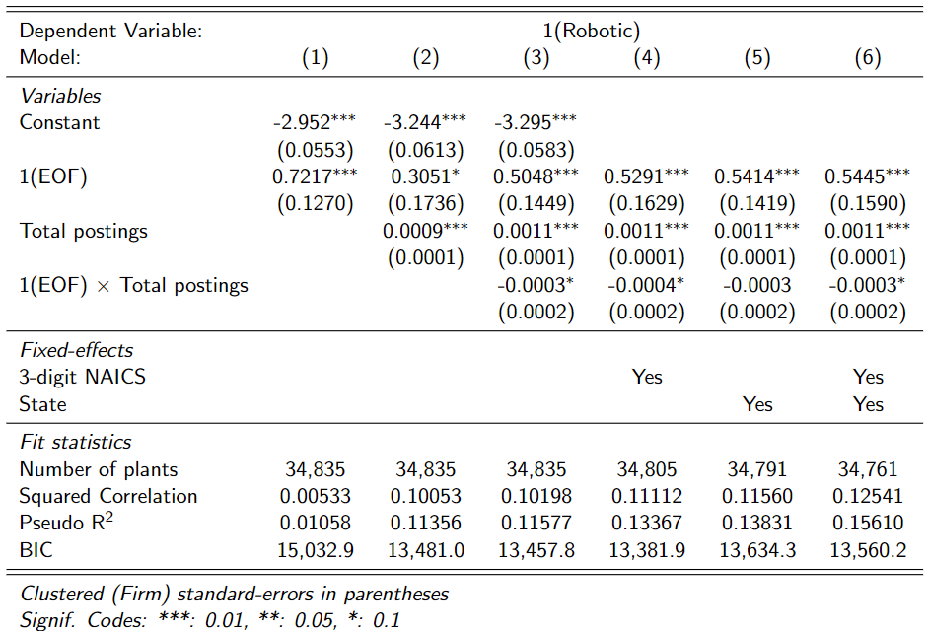
are EOF more/less likely to adopt robots?
Note: Sample limitation does not allow us to use NAICS x commuting zone fixed effects. This combination produces 4,674 fixed effects, among which 299 have more than 3 EOFs and CFs.

Slide 16
Interpretations
EOFs are more likely to adopt robots
The results are robust after controlling for size, industry, and year
Using NAICS + commuting zone fixed effects does not alter the results

Slide 17
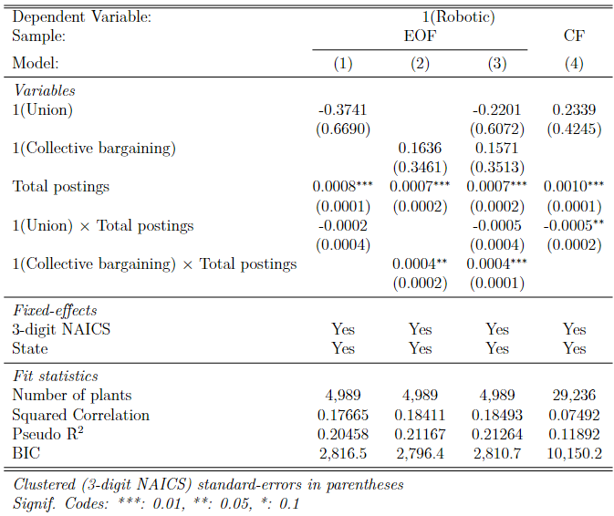
Are EOF/CF with better participative mechanisms more/less receptive to robots?
Note: Sample limitation does not allow us to use NAICS x commuting zone fixed effects. This combination produces 4,674 fixed effects, among which 299 have more than 3 EOFs and CFs.

Slide 18
Interpretations
Unionized CFs are less likely to adopt robots
No union effect on EOFs
Collectively-bargained EOFs are more likely to adopt robots
Adding 1(union) to column 3 increases the significance of 1(Collective Bargaining)

Slide 19
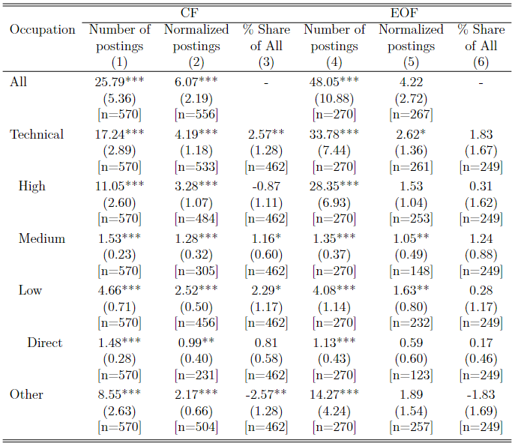
do hiring activities change following robot adoption?
Notes:
N indicates number of adopters
Relative magnitude of All postings from pre-adoption:
CF: 44.8%
EOF: 42.4%

Slide 20
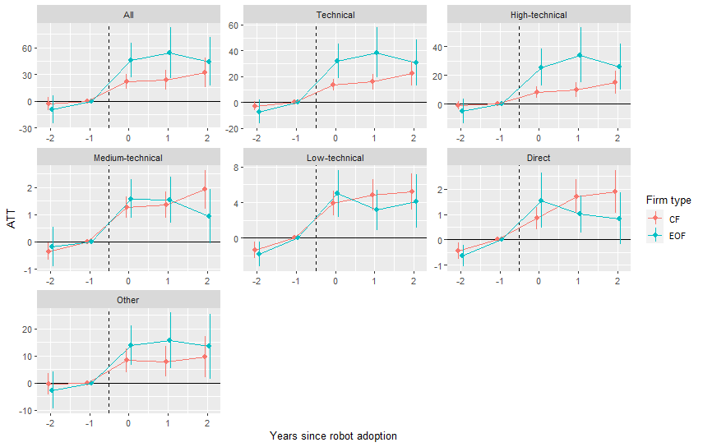
Event-study analysis on unadjusted number of postings
Notes:
Add normalized and share

Slide 21
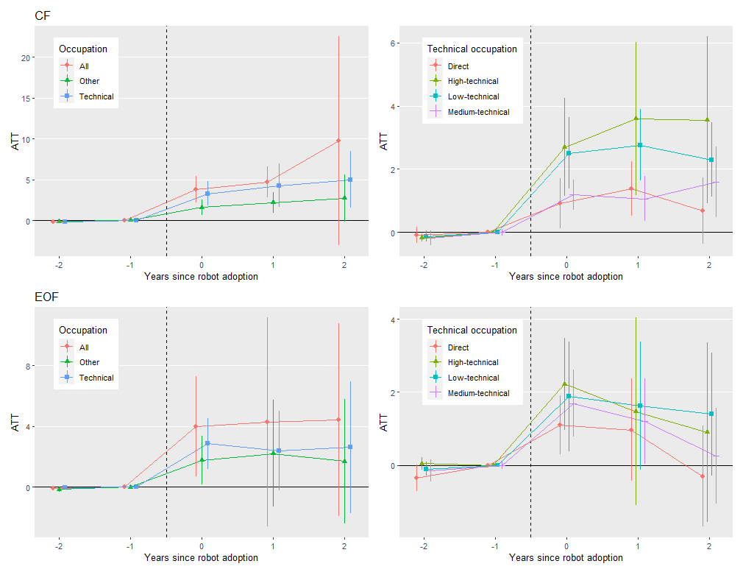
Normalizing postings to remove size differences

Slide 22
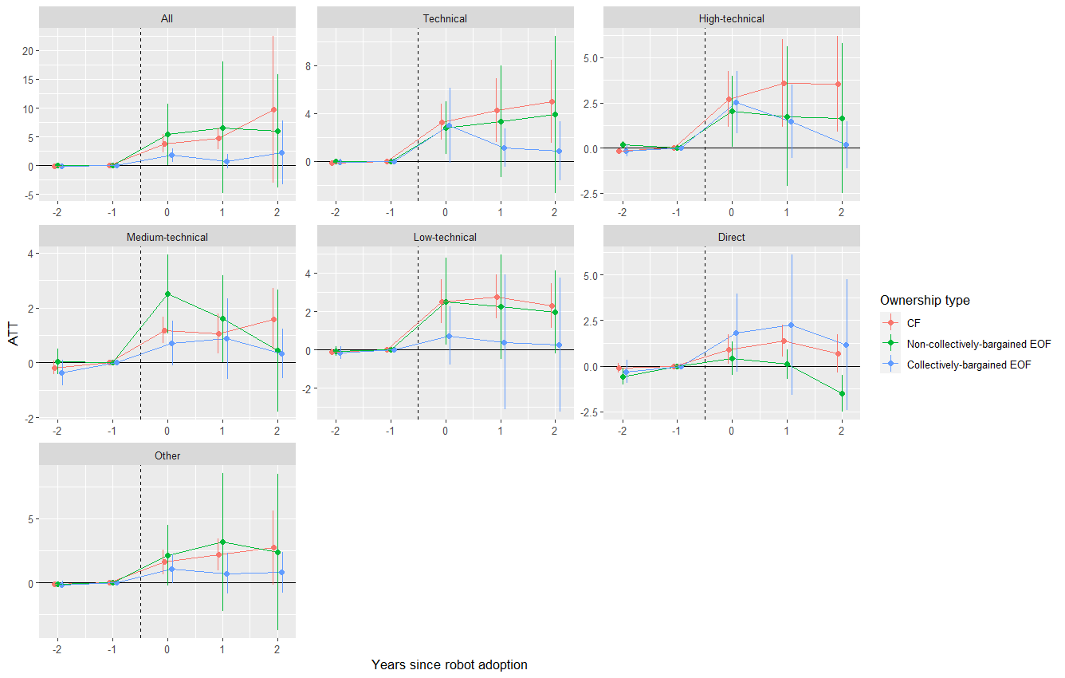
Splitting EOF by collective bargaining shows No significant difference But, HIRING from Collectively-bargained EOF resembles CF

Slide 23
Interpretations
Robotic plants increase their hiring post-adoption
Normalized postings indicate greater hiring in CF
Non-collectively bargained EOF seems to follow the pattern of CF
Need to investigate this further, as the difference between CB—Non-CB is not significant

Slide 24
Conclusion: Are EOF luddites?
When employees given better voice → more receptive to the adoption of technology
Firms with broad-based employee ownership are more likely to adopt robots
The presence of a union hinders adoption in CFs, but not EOFs
When EOF is introduced due to collectively bargaining between employers and employees, firms are more likely to adopt
Robot adoption increases hiring in both types of firm
Indicating productivity and complementarity effects outweigh substitution effect
EOF preserving employment stability (Kurtulus and Kruse, 2018)

Slide 25
Thank you

Slide 26
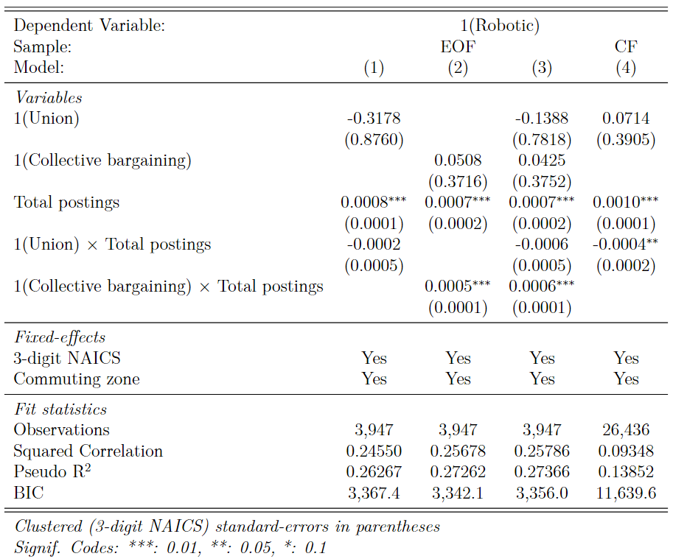
Are EOF/CF with better participative mechanisms more/less receptive to robots? Commuting zones instead of States
Note: Sample limitation does not allow us to use NAICS x commuting zone fixed effects. This combination produces 4,674 fixed effects, among which 299 have more than 3 EOFs and CFs.

